Slide 1
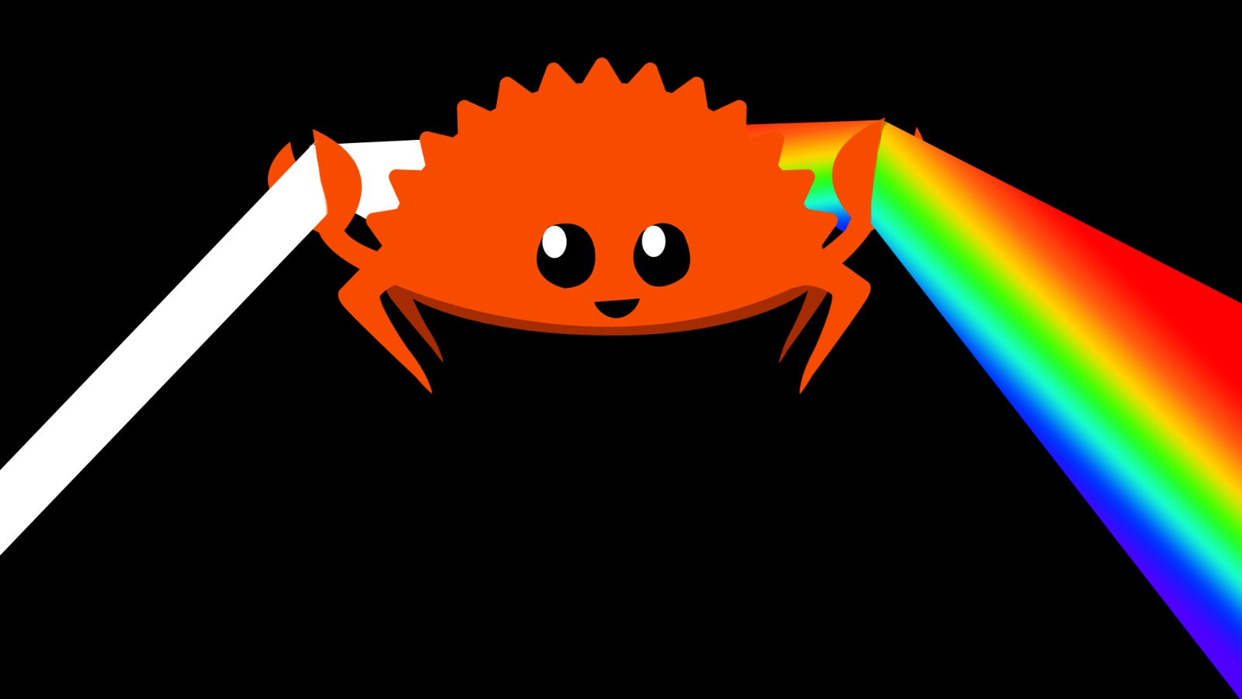
Rusterizer Masterclass “Hello Triangle!”
Luca Quartesan – quartesan.l@buas.nl – 03-10/02/2021

Slide 2
Welcome v0.2
Features that we are not going to implement are marked with 🚩
🚩are left behind so you can expand on what we see during the lectures

Slide 3
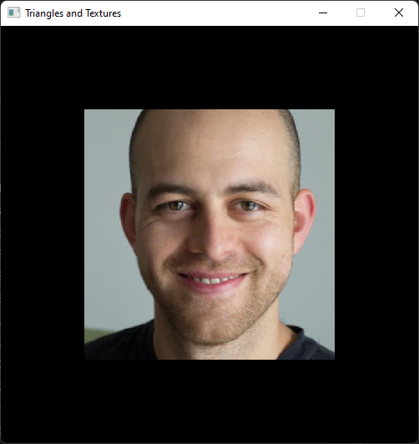
Agenda
Last Episode
Shading
Multiple Triangles
Textured Triangles
Textured Quad

Slide 4
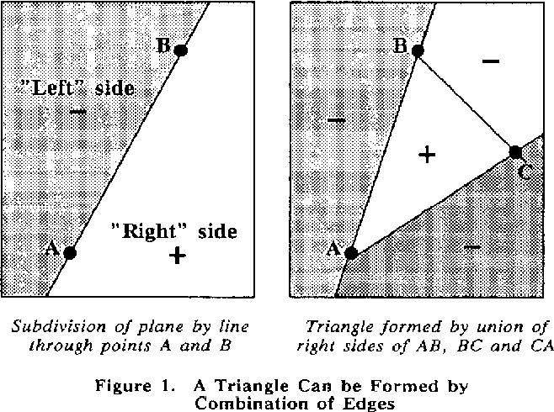
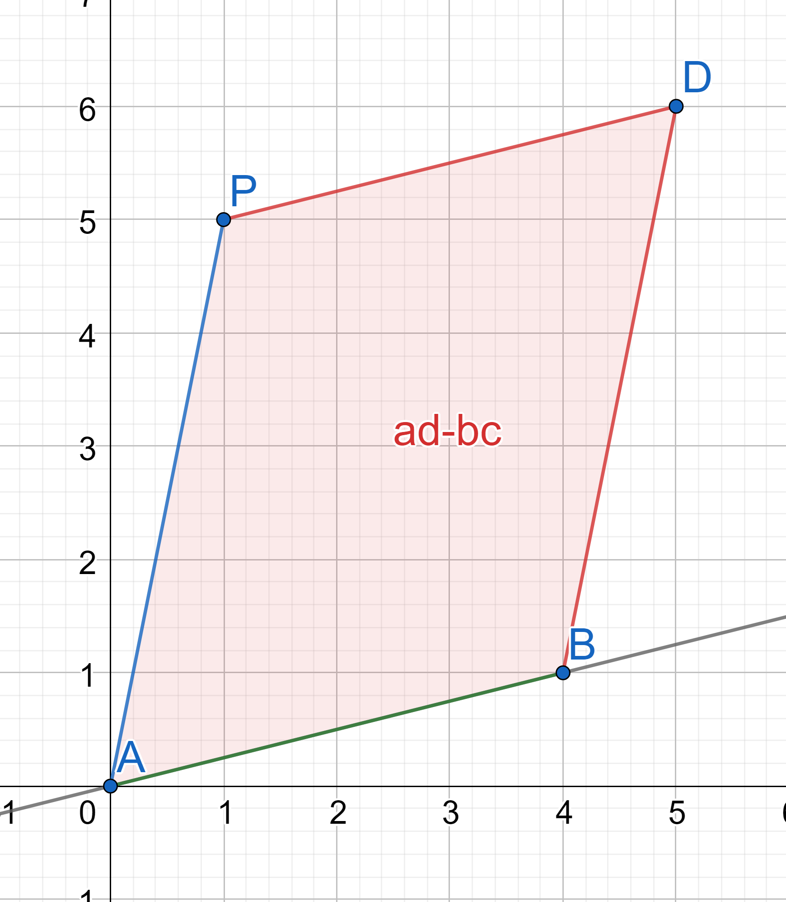
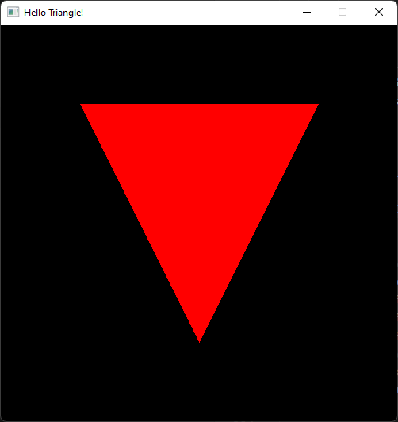
Last Episode
Edge function tells on which side of a line a point lies
Calculated using matrix determinant (cross product), which returns the signed area of the parallelogram
We compute the edge function for each edge
If all positive then the point is inside the triangle
Did you try with counter clockwise triangles?

Slide 5
Vertex Data
Triangles are used to represent surfaces, each vertex can contain multiple information
Only positions we would get only flat surfaces
position (required)
normal
uvs - Texture coordinates
Color
for now let’s focus on position and color

Slide 6

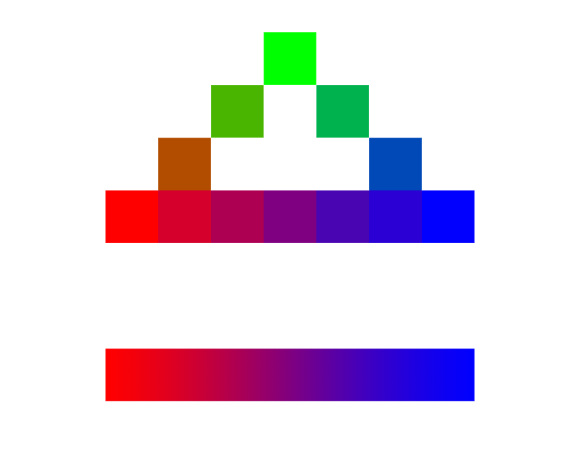
Shading
if we use the Scanline/Bresenham algorithm we would linearly interpolate (lerp)↗️
From vertex to vertex
Horizontally for each scanline
🚩if you have implemented Bresenham you can implement shading with lerp
0.0
0.16
0.33
0.5
0.66
0.83
1.0

Slide 7
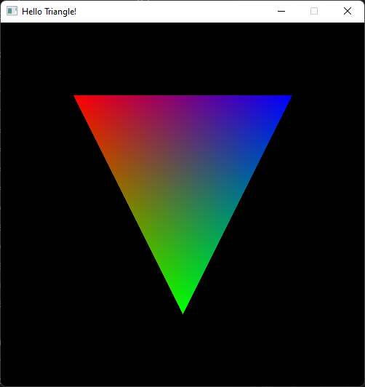
Barycentric coordinates
barycentric coordinates: location of a point is described in relation to the triangle vertices
They can be interpreted as masses placed at the 3 vertices.
These masses are all positive if and only if the point is inside the triangle.

Slide 8


Barycentric coordinates
we can describe the position of a point in cartesian coordinates using barycentric coordinates as "weights"
the barycentric coordinate also tells us how much each vertex "contributes" to the point evaluated

Slide 9
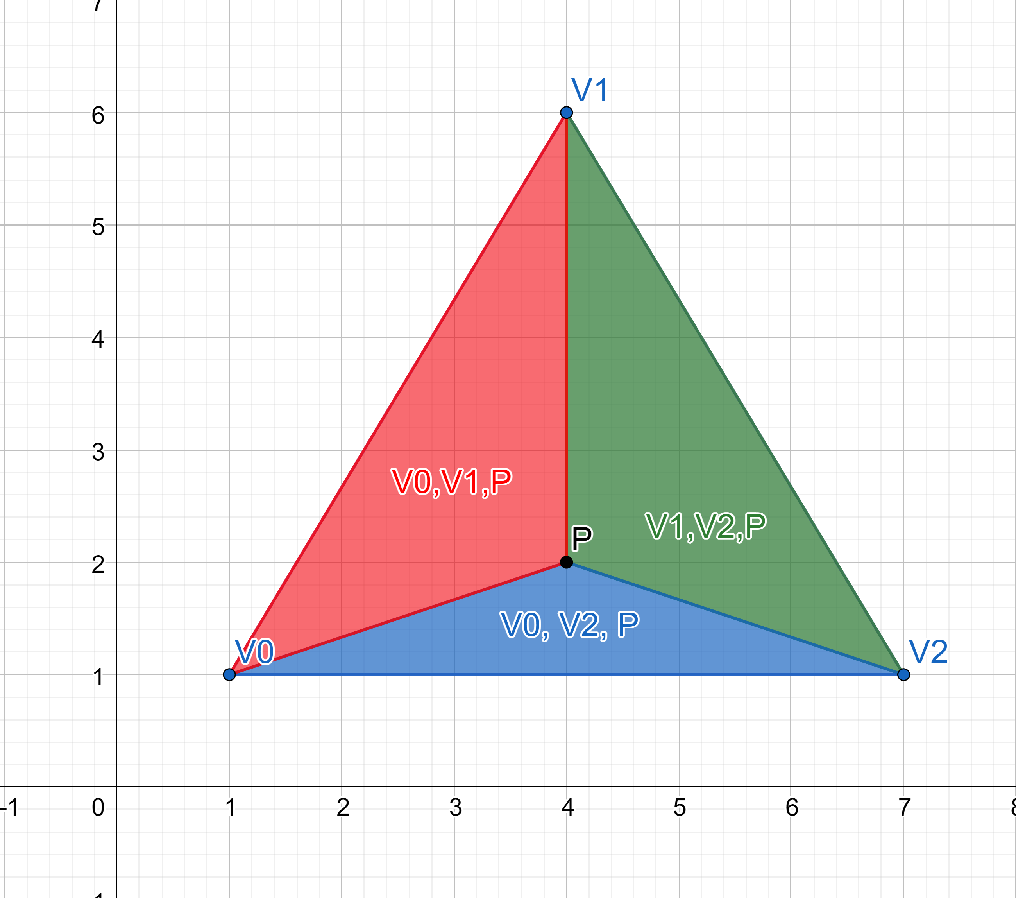
Barycentric coordinates
In the context of a triangle, are also known as area coordinates or areal coordinates
The proportion between each of the 3 areas formed and the whole triangle area

Slide 10
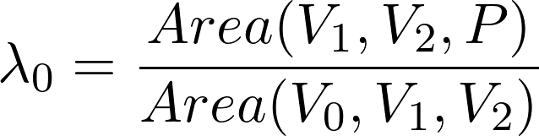
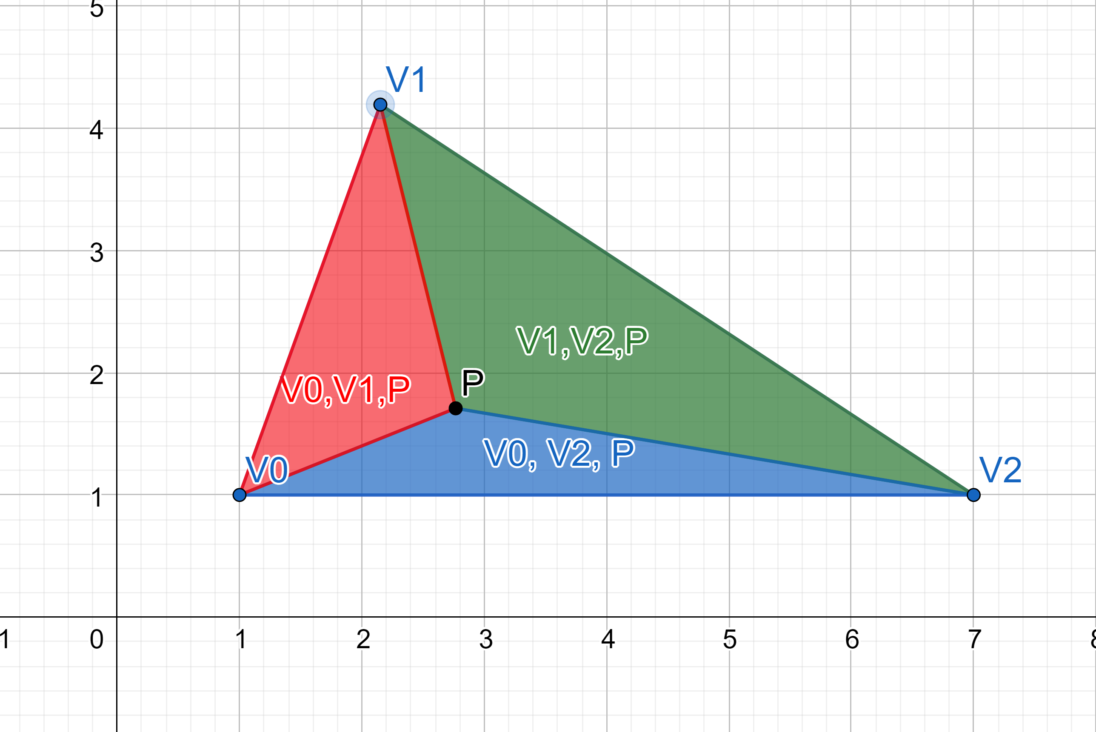
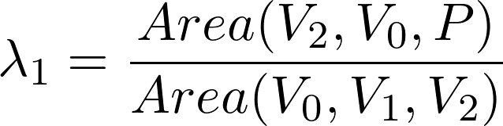
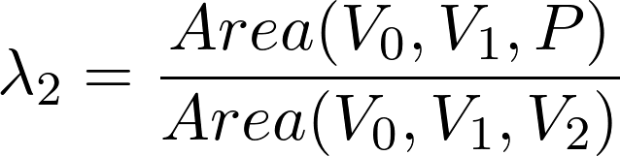
Barycentric coordinates
🤔 Can you guess one of the properties of these three values?
https://www.geogebra.org/geometry/fngcbnjv
https://www.geogebra.org/m/rFQK2EH3#material/YYmc5Mx2

Slide 11
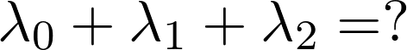
Barycentric coordinates

Slide 12
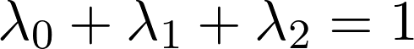
Barycentric coordinates

Slide 13

Interpolate Vertex attributes
In the same way we derive the cartesian coordinates from barycentric, we can also use this weights to interpolate the other vertex values
for example the color:

Slide 14
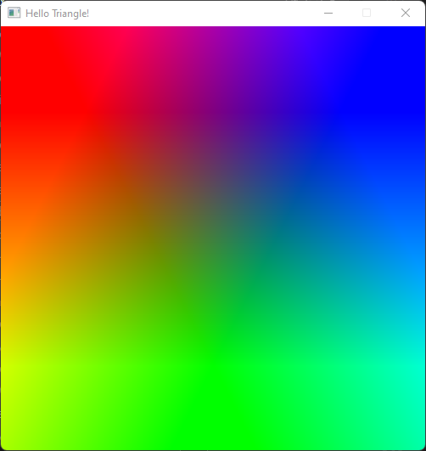
Interpolate Vertex attributes

Slide 15
Interpolate Vertex attributes

Slide 16
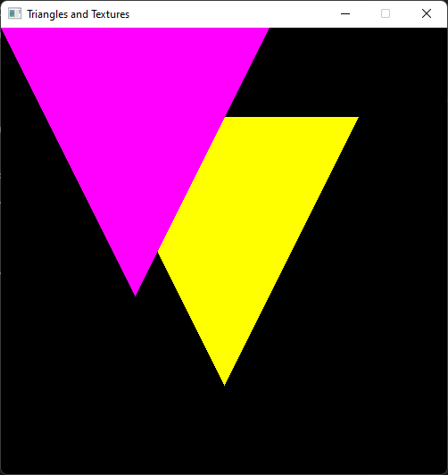
Multiple Triangles!
Let’s add another triangle
🤔What is going on here?
Why is the pink one on top?

Slide 17
Multiple Triangles!
Let’s add another triangle
🤔What is going on here?
Why is the pink one on top?
We just rasterize it last!

Slide 18
Rasterization/Fill rules
Rasterization rules define how vector data is mapped into raster data. The raster data is snapped to integer locations that are then culled and clipped (to draw the minimum number of pixels), and per-pixel attributes are interpolated (from per-vertex attributes) before being passed to a pixel shader. Rasterization rules | Microsoft

Slide 19
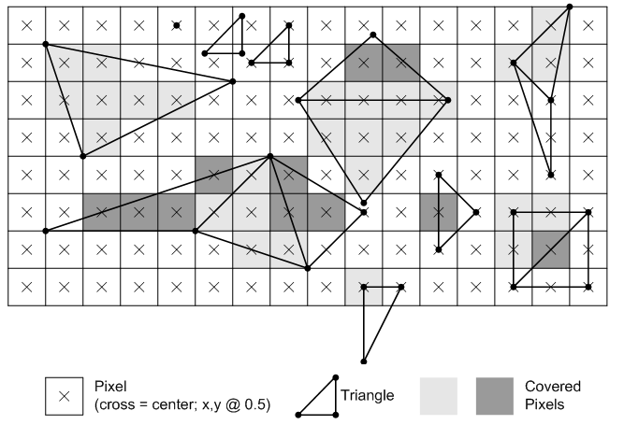
🚩Top-left rule
A top edge, is an edge that is exactly horizontal and is above the other edges.
A left edge, is an edge that is not exactly horizontal and is on the left side of the triangle
Rasterization rules | Microsoft

Slide 20
🚩Top-left rule
Any pixel center which falls inside a triangle is drawn; a pixel is assumed to be inside if it passes the top-left rule. The top-left rule is that a pixel center is defined to lie inside of a triangle if it lies on the top edge or the left edge of a triangle.
Rasterization rules | Microsoft
🤔Are we doing something wrong based on this?

Slide 21
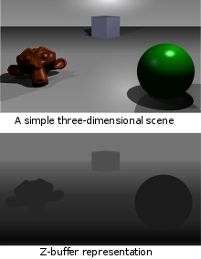
Depth buffer (z-buffer)
It’s time to take into account a third dimension
Now we can check their z (depth)
store the depth of each pixel
the one in front wins >z and writes to the buffer
https://en.wikipedia.org/wiki/Z-buffering

Slide 22
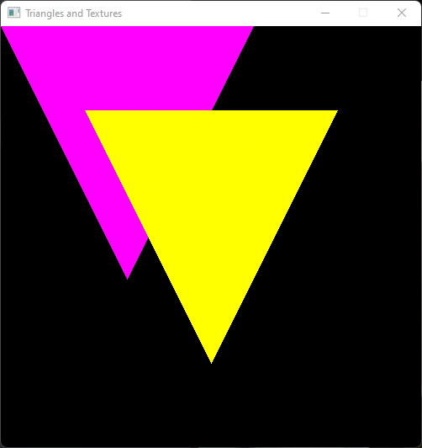
Depth buffer

Slide 23
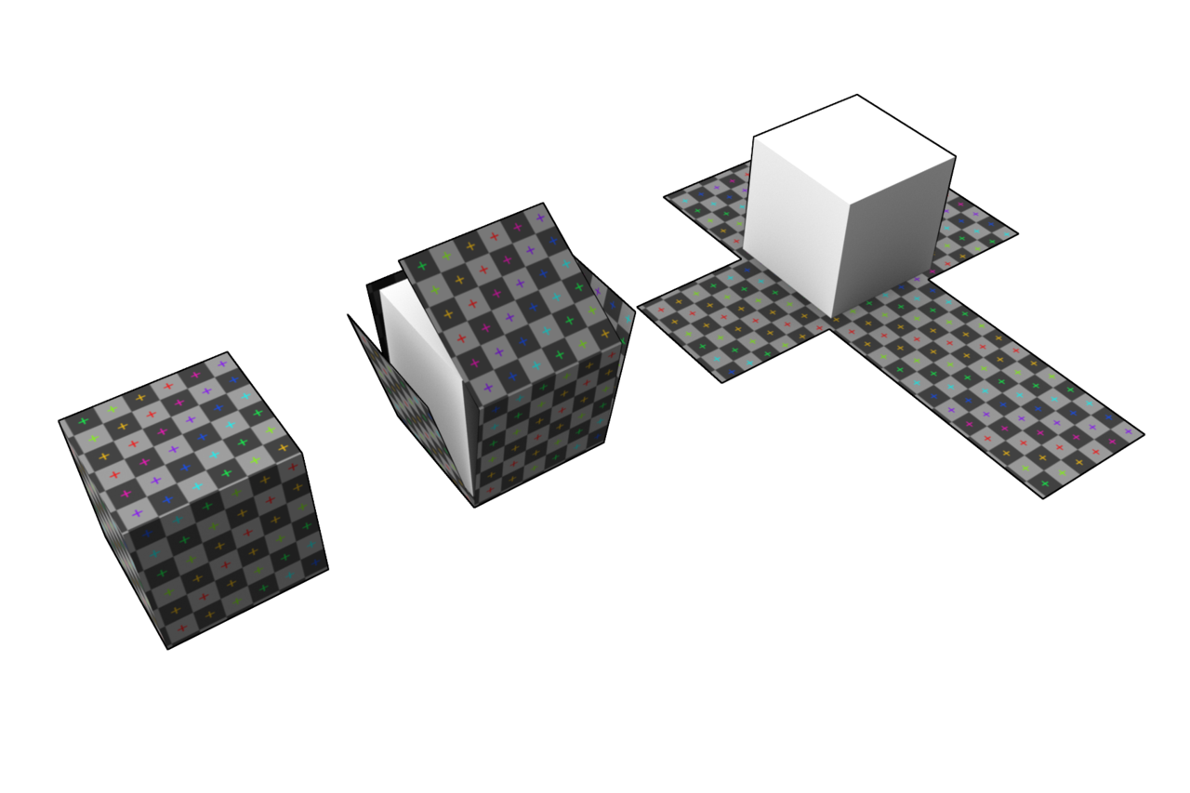
Textures and triangles
maps the surface into texture space UV
Texture mapping => can define details of a surface through a texture
https://en.wikipedia.org/wiki/UV_mapping

Slide 24
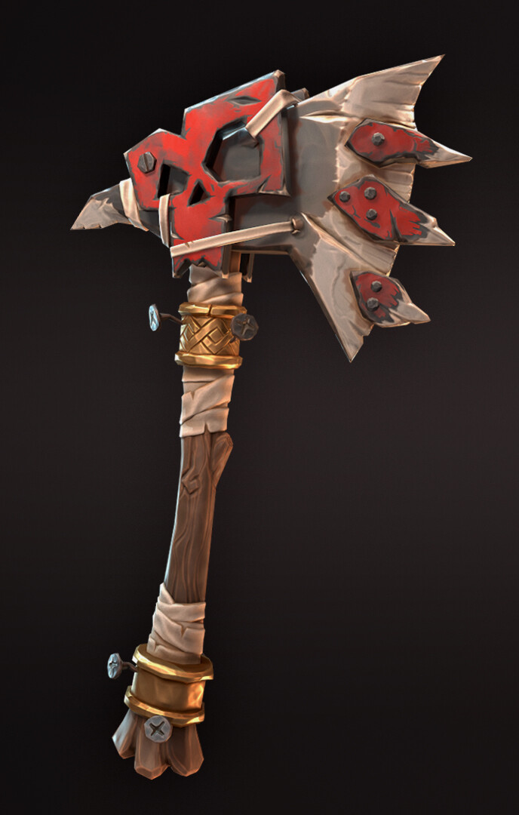
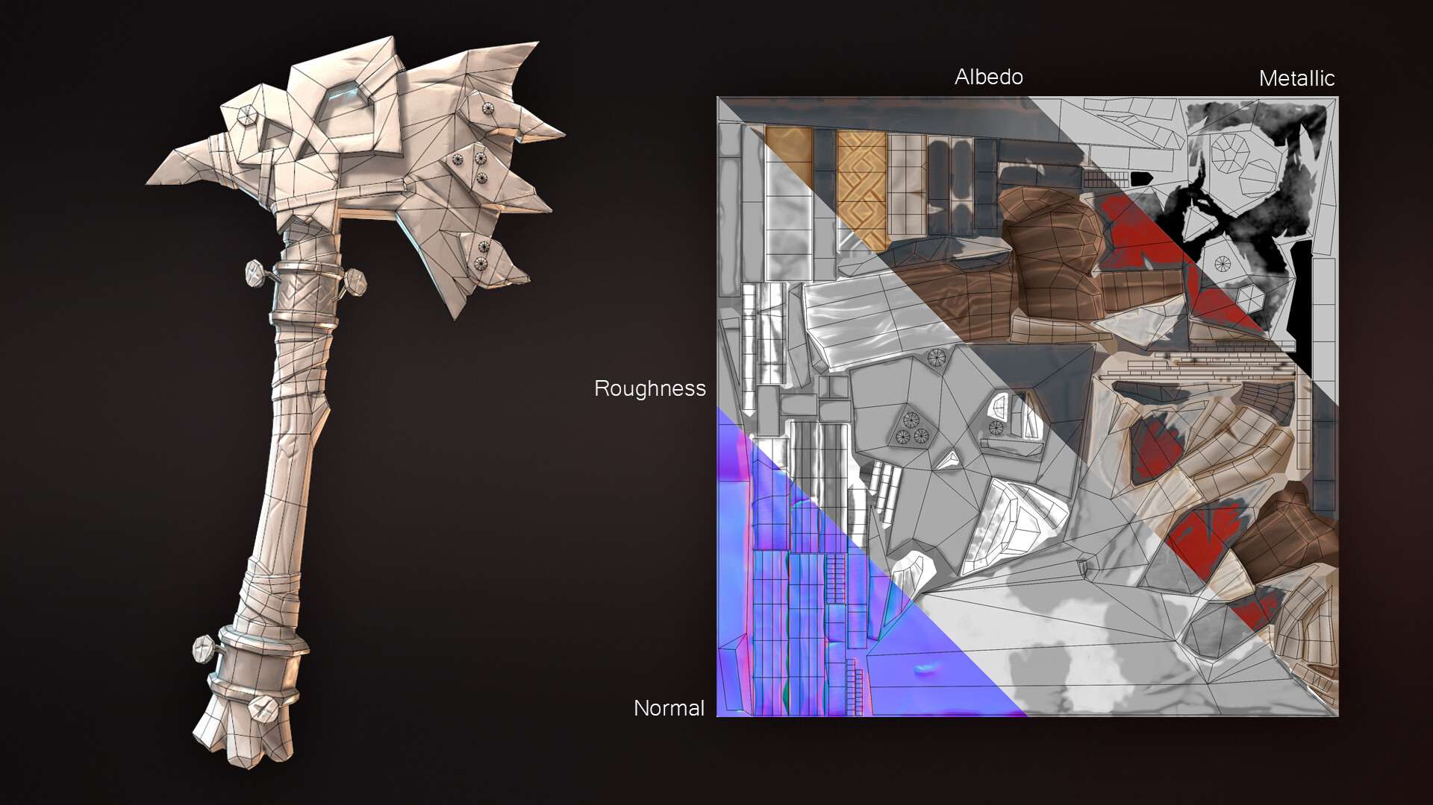
UV mapping
Textures can describe many properties of our surface and material:
Color/Albedo
Normal
Metallic
Roughness
AO....
https://www.artstation.com/jorisvanhugten

Slide 25
UV Mapping
https://www.artstation.com/jorisvanhugten

Slide 26
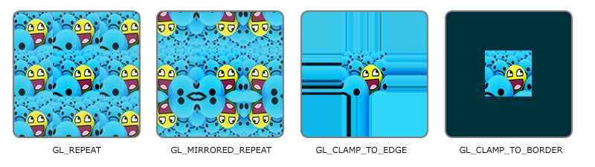
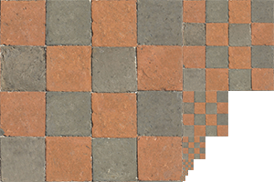
Textures
2D representation and vertex attribute:
Texture coordinates from 0,0 to 1,1
🚩 Textures may be repeated or mirrored⬆️
🚩Mipmapping is a thing ➡️
🚩Many sampling methods:
Nearest, Linear, ...
https://learnopengl.com/Getting-started/Textures

Slide 27
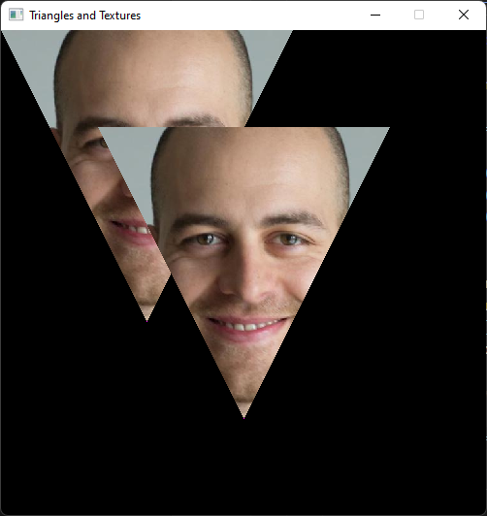
Textured Triangle
We can interpolate UV coords like any other vertex coordinate

Slide 28
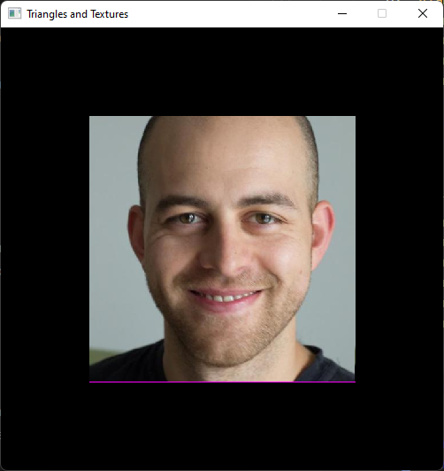
A textured Quad
🤔What’s going on?

Slide 29
A textured Quad
We want the center of the pixel (top-left slide)
Now we are using the corner
Easy fix 🦀

Slide 30
A textured Quad
Fixed!

Slide 31
Thank you! 🦀
Many questions?

Slide 32
You could try
Bresenham + interpolation
Top-left rule
Transformations? Next eppi: 3D

Slide 33
Resources
Rasterization: a Practical Implementation
Optimizing Software Occlusion Culling – index | The ryg blog
Texture Mapping & Polygon Rasterizing Tutorial (1/2) [C++20] – YouTube
3D Programming Fundamentals [Introduction] Tutorial 0 – YouTube
Rasterizer Algorithm Explanation - YouTube

